Slide 1
Detecting Political Bias
in News Articles Using Deep Learning
KTPML: Lasya Suravajhela, Kellin Harris, Prashant Joshi, Michael Long, Tracey Peyton
Notes:
Welcome everyone. Today we're presenting our project on using deep learning to detect political bias in news articles at the individual article level — not just by source. We'll walk you through our question, our approach, our results, and what we think they mean.

Slide 2

Introduction
Imagine you are reading two news articles about the same economic report. One leads with job growth and the other leads with wage stagnation.
It's the same data, same day, but you were presented the information in a different way
This is political framing in media and many readers don’t notice it happening.

Slide 3
Motivation
Why should we care?
Media bias is pervasive
Most tools classify bias at the source level by labeling outlets but they fail to categorize individual articles.
6
Article-level matters
A right-leaning outlet may publish centrist or nuanced content. Source labels miss this.
news sources
tested
Real-world impact
BBC · ABC · CBC
FOX · Al Jazeera · NPR
Bias detection can inform media literacy tools, recommendation systems, and content moderation.
The Distributional Hypothesis: "You shall know a word by the company it keeps."
Notes:
Political bias in media is well-documented, but most existing tools — like the Ad Fontes Media Bias Chart or AllSides — classify entire outlets, not individual articles. Our project asks: can we do better? Can we look at the text of an article itself and determine its political leaning? This has real downstream applications: a reader literacy tool, a recommendation engine that surfaces ideologically diverse content, or an automated moderation pipeline.

Slide 4
Research Question
Can political leaning be identified at the article level from learned text representations alone, without relying on source-level labels?
Notes:
Here, our central question is whether we can determine political leaning just by analyzing the text of an article. This idea is grounded in the Distributional Hypothesis, which suggests that words appearing in similar contexts tend to have similar meanings. To start, we built a bidirectional LSTM that learned word embeddings from scratch. Based on feedback from reviewers, we later switched to an ordinal DistilRoBERTa model. What sets our approach apart is that we focus on labeling individual articles based only on their content, rather than relying on the source.

Slide 5
Related Work
How does our approach compare?
Source-level
Baly et al. (2018) — Predicting Factuality and Bias of News Sources
Source-level classification using Wikipedia and Twitter data. Strong results but limited to outlet-level labels.
BERT-based
Loiya et al. (2026) — ChunkyBERT: Multiclass Political Bias Detection
BERT-based chunking approach for long-form political text. Higher accuracy but far more compute-intensive.
Our approach
Ours (2026) — Bidirectional LSTM, Article-Bias-Prediction Dataset
Article-level classification using learned embeddings. 61.4% accuracy — competitive baseline with room to grow.
Notes:
To put our work in context, we drew on several important papers. Baly et al. 2018 is a foundational study on classifying political bias at the source level. More recently, ChunkyBERT introduced transformer-based chunking, which achieves higher accuracy but at the cost of much greater computational resources. By incorporating a transformer into our own method, we aimed to close that performance gap. We also made use of the EMNLP 2020 Article-Bias-Prediction paper, which provided our dataset, a helpful suggestion from our instructor after our initial proposal.

Slide 6
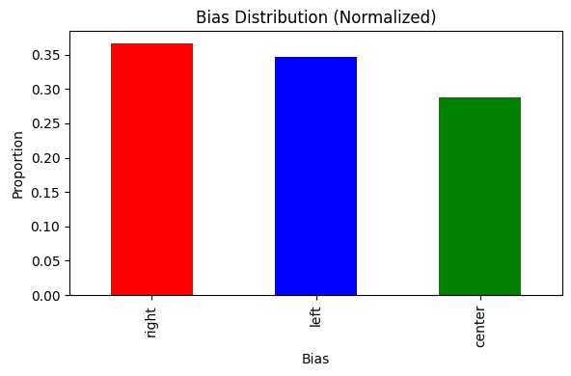
Dataset
Article-Bias-Prediction (EMNLP 2020)
37,554
12
0
1,084
Total Articles
Columns
Missing Values
Avg. Word Count
Class Distribution
Right 36.6%
Left 34.6%
Center 28.8%
Notes:
We used the Article-Bias-Prediction dataset from the EMNLP 2020 paper. It has 37,554 articles across 12 columns including article content, source, and bias label. Crucially, there are zero missing values, the class distribution is fairly balanced across left, right, and center, and articles average over 1,000 words — plenty of signal for a sequence model. The labels come from external media bias assessments aggregated across multiple organizations, which is more robust than a single source's judgment.

Slide 7
Baseline Approach
Bidirectional LSTM Pipeline
1. Preprocess
2. Tokenize
3. Embed
4. BiLSTM ×2
5. Classify
Lowercase, strip URLs,
special chars, digits
Top 5,000 tokens
Max 500 tokens/article
128-dim learned
embedding layer
64 units each
Dropout 0.5
Dense → Softmax
Left / Center / Right
Model Architecture
Embedding Layer:
Vocabulary: 5,000 tokens | Dimensions: 128
Bidirectional LSTM ×2:
64 units each | return_sequences=True on first layer
Dense Layers:
128 → 64 units | ReLU activation | Dropout 0.5 after each
Output Layer:
3 units | Softmax | Optimizer: Adam (lr=0.001)
Training:
80/20 stratified split | Early stopping (patience=3) | Best epoch restored
Notes:
Here, you can see the first version of our pipeline, which uses a BiLSTM model. The process starts by preprocessing the article text, tokenizing it, keeping the top 5,000 words, and then padding or truncating each sequence to 500 tokens. The model learns 128-dimensional word embeddings from scratch and uses two stacked bidirectional LSTMs to classify articles as left, center, or right via softmax. This baseline reached 61.4% accuracy, which is well above the 33% expected by chance. However, after receiving feedback from reviewers, we realized there was room to improve both the model architecture and the loss function. The next two slides walk through the changes we made and why.

Slide 8
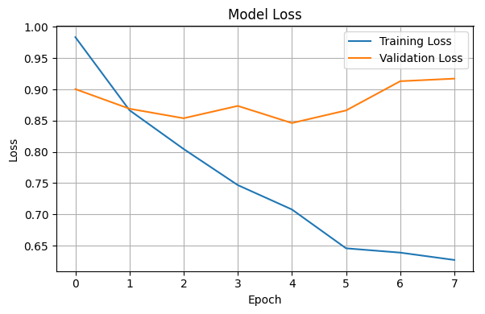
Baseline Result 1: Training & Convergence
7
Epochs until
early stop
4
Best epoch
(weights restored)
61.4%
Val accuracy
at best epoch
69.8%
Train accuracy
at best epoch
Training accuracy (70%) > Validation accuracy (61%) — model is learning without severe overfitting.
Notes:
The BiLSTM model trained for 7 epochs, but early stopping kicked in and brought us back to the weights from epoch 4, which is where the model generalized best. We saw a validation accuracy of 61.4%, compared to a training accuracy of 69.8%. This suggests the model was able to pick up on real patterns in the data without overfitting too much. These results give us a solid starting point and show that the task is indeed learnable, setting a clear benchmark for our improved model to beat.

Slide 9
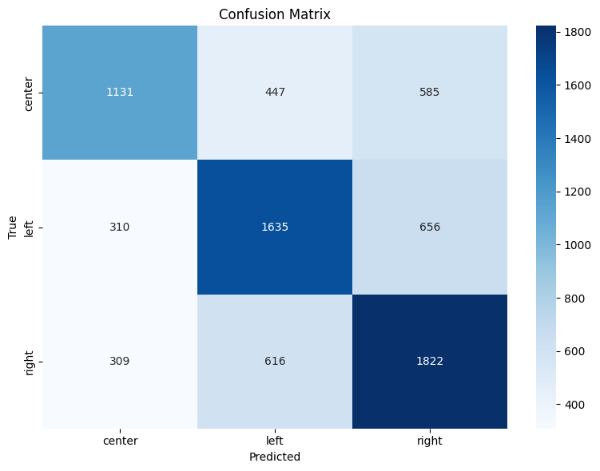
Baseline Result 2: Classification Performance
Held-out test set — 7,511 articles
61.4%
Test Accuracy
(vs. 33% random baseline)
Per-Class Performance
Class | Precision | Recall | F1
Center | 0.65 | 0.52 | 0.58
Left | 0.62 | 0.61 | 0.61
Right | 0.59 | 0.70 | 0.64
Center articles are hardest to classify — often confused with left or right. This makes linguistic sense: centrist writing shares vocabulary with both poles.
Notes:
When we tested the BiLSTM on 7,511 articles that weren’t used in training, it reached 61.4% accuracy, almost double what you’d expect from random guessing. The model did best on right-leaning articles, with an F1 score of 0.64, followed by left at 0.61, and center at 0.58, which proved trickier. The confusion matrix shows that center articles often get misclassified as left or right, which makes sense since centrist writing tends to share vocabulary with both sides. Keep these numbers in mind, because our upgraded model improves on all three categories.

Slide 10
Applying the Baseline Model to Real-World Articles
1,990 freshly scraped articles
BBC
727
FOX
259
ABC
417
Al Jazeera
220
CBC
287
NPR
80
Out-of-Sample Prediction Summary
Center predicted:
49.9%
Avg confidence:
64.5%
Left predicted:
31.9%
Articles < 0.5 confidence:
~28%
Right predicted:
18.2%
Shift toward center vs. balanced training data — consistent with sources being broadly centrist on the Media Bias Chart.
Notes:
To see how the baseline model performed in practice, we tested it on 1,990 new articles from six different sources. None of these articles were in our training set, so this was a true out-of-sample test. The model’s predictions leaned toward the center: 49.9% center, 31.9% left, and 18.2% right, which matches the fact that most of our sources are close to the center on the Media Bias Chart. The average confidence was 64.5%, and about 28% of articles had confidence scores below 0.5.

Slide 11
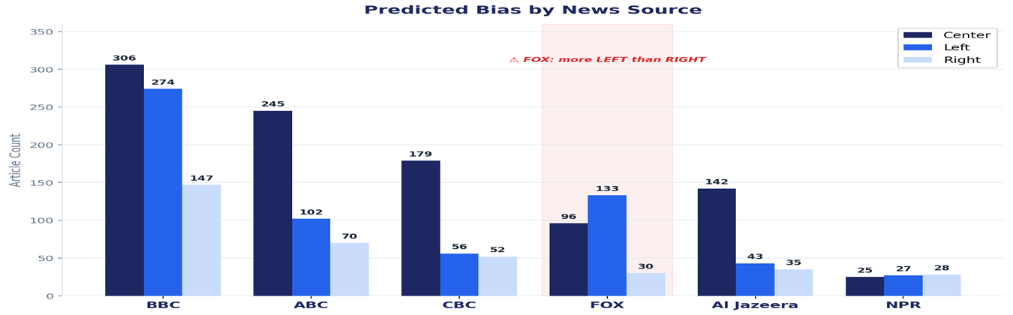
Key Result: Predictions by Source
Baseline LSTM predictions: where the baseline model succeeds and where it reveals its limits
FOX Misclassification
133 articles predicted LEFT
30 articles predicted RIGHT
NPR Expected Uncertainty
Center: 25 | Left: 27 | Right: 28
Nearly even split — model is appropriately unsure
Notes:
This is our most important slide concerning our baseline model. The per-source breakdown tells a nuanced story. NPR, which we originally designated as a centrist validation source, is predicted nearly evenly across all three classes. The model doesn't know what to do with it, which is actually the right answer for a genuinely centrist outlet. FOX is the surprise. Despite being widely recognized as right-leaning, the model labeled more FOX articles as left than right. This is our key finding, it tells us something important about what the model actually learned.

Slide 12
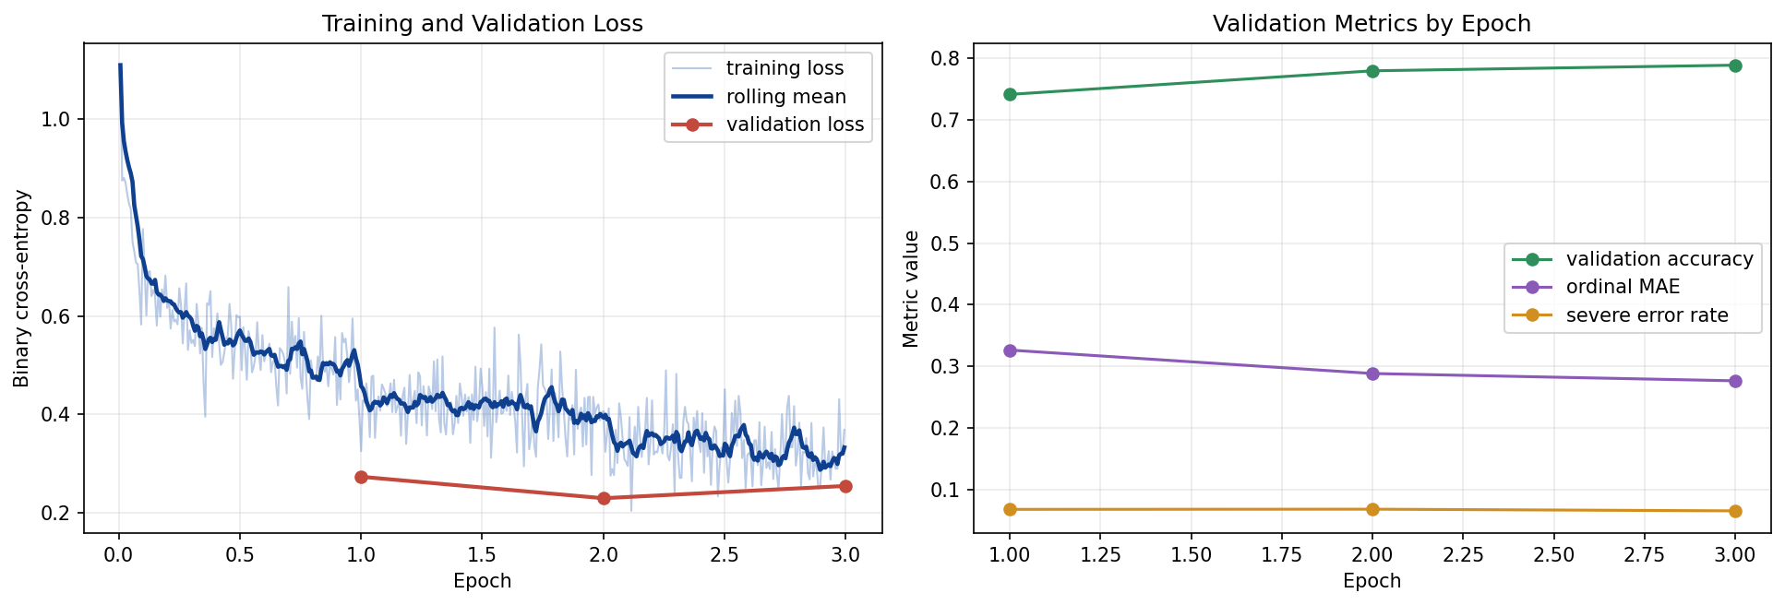
Model Upgrade: Addressing Feedback
From BiLSTM to Ordinal DistilRoBERTa
Feedback 1: Use a Transformer
Updated Architecture
LSTM trains embeddings from scratch. RoBERTa uses pretrained contextual embeddings; the same word carries different representations depending on context.
Base Model:
DistilRoBERTa (distilroberta-base)
Tokenization:
Subword, max 128 tokens
Feedback 2: Use Ordinal Encoding
Classifier:
Linear → 3 ordinal logits
Softmax treats all errors equally. Ordinal encoding: left=(1,0,0), center=(1,1,0), right=(1,1,1). Binary cross-entropy penalizes far-off errors more strongly.
Loss:
Binary cross-entropy per bit
Training:
3 epochs, full fine-tune (82M params)
Notes:
After we shared our first results, we got two helpful suggestions. The first was to try a transformer model like RoBERTa instead of an LSTM, since transformers can capture more context in the text. The second was to use ordinal encoding, which treats left, center, and right as points along a spectrum, so that mistakes between left and right are penalized more than mistakes between left and center. We took both pieces of advice: we upgraded to DistilRoBERTa, a lighter version of RoBERTa that’s already been trained on large text corpora, and we swapped out softmax for cumulative ordinal encoding using binary cross-entropy for each bit.

Slide 13
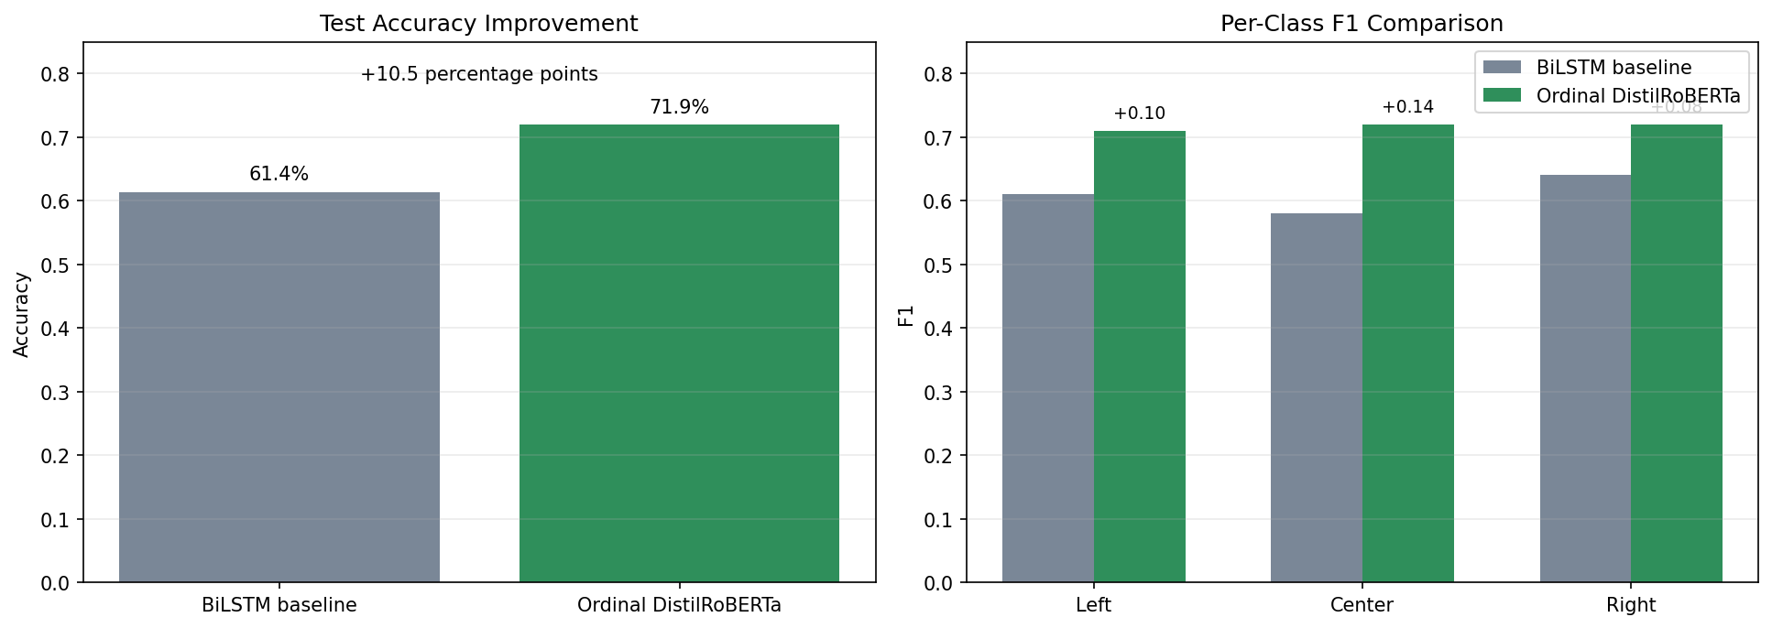
Improved Results: BiLSTM vs. Ordinal DistilRoBERTa
Both feedback points implemented — significant gains across all metrics
FOX Misclassification — RESOLVED
NPR Centrist Prediction — IMPROVED
FOX right share: 11.6% (LSTM) → 74.9% (RoBERTa) FOX left share: 51.4% (LSTM) → 8.5% (RoBERTa)
NPR center share: 31.3% (LSTM) → 64.7% (RoBERTa) Model now correctly identifies NPR as centrist.
New ordinal metrics: Ordinal MAE = 0.39 | Severe Error Rate = 10.9% | 935 exact | 223 adjacent | 142 opposite-pole
Notes:
After the upgrade, we saw improvements across every metric we tracked. Overall accuracy jumped from 61.4% to 71.9%, which is a solid 10.5 percentage point increase. Looking at the F1 scores for each class, all three categories improved, but the biggest gain was in center articles, which went from 0.58 to 0.72. This is especially important because the center class has always been the hardest for the LSTM to get right. We also have two new metrics that give us a better sense of model performance. The ordinal MAE is 0.39 on a 0-to-2 scale, so on average, predictions are less than half a step off on the ideological spectrum. The severe error rate is 10.9%, meaning about one in nine predictions are completely flipped to the opposite side. What stands out most is that both FOX and NPR stories, our main baseline examples, show much better results after the upgrade.

Slide 14
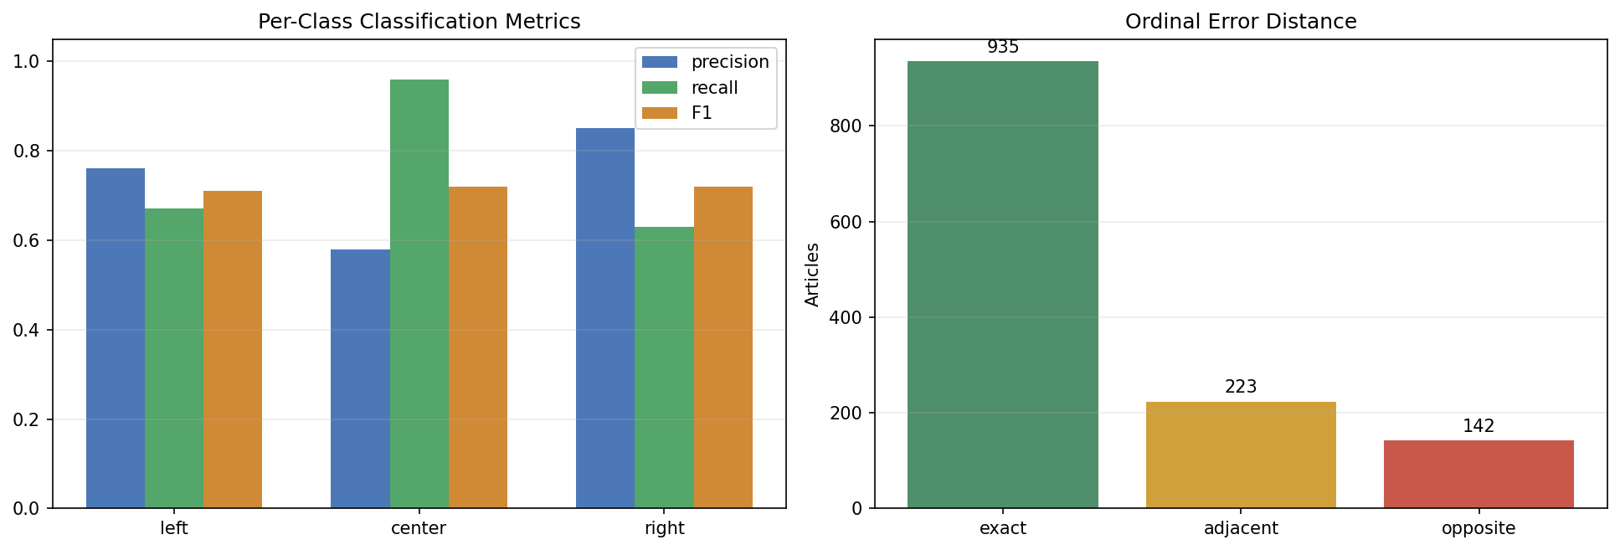
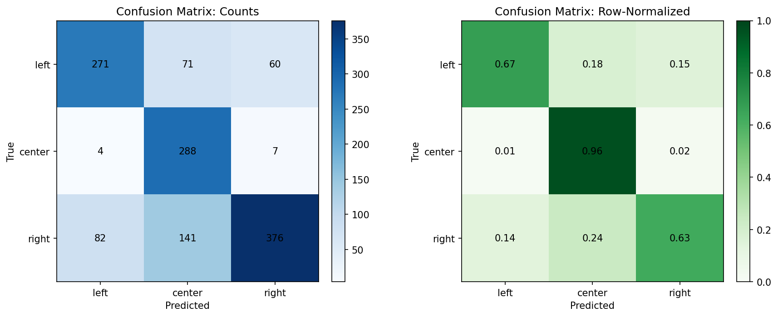
Updated Model: Confusion Matrix & Per-Class Performance
Center is now the strongest class (recall 0.96) — errors are mostly adjacent, not opposite-pole
Key insight: Center precision (0.58) is low despite high recall (0.96) — the model over-predicts center when uncertain. Right articles most affected: 141/599 pulled toward center, but only 82 confused with left. Ordinal error distance shows 935 exact, 223 adjacent, 142 opposite-pole predictions.
Notes:
Now, looking more closely at the confusion matrix, the center row really stands out: 288 out of 299 center articles were predicted correctly, which gives us a recall of 0.96. This is a dramatic improvement compared to the LSTM, where center was consistently the weakest class. The normalized matrix backs this up; center is now almost perfectly identified. The main area where the model still struggles is with right-leaning articles: 141 out of 599 are being pulled toward the center, so the right recall is only 0.63. However, it's important to note that only 82 right articles are confused with left, which shows the ordinal model is behaving as intended. When the model misclassifies right articles, it tends to err toward center rather than jumping across the spectrum. The ordinal error distance chart illustrates this: 935 exact predictions, 223 adjacent-class errors, and only 142 opposite-pole confusions. In short, the ordinal encoding is doing exactly what it was designed to do.

Slide 15
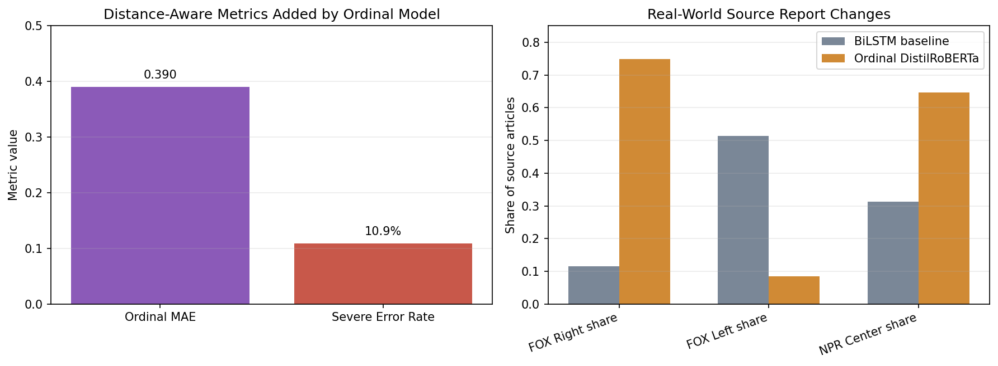
Key Result: Predictions by Source
Ordinal DistilRoBERTa predictions
Before vs. after upgrade — FOX right share: 11.6% → 74.9% | NPR center share: 31.3% → 64.7%
Notes:
This slide makes it clear how much things improved after the upgrade. For FOX, the percentage of articles predicted as right increased from 11.6% to 74.9%, which is a complete reversal. At the same time, FOX articles predicted as left dropped from 51.4% to just 8.5%. For NPR, the proportion of center predictions rose from 31.3% to 64.7%. Essentially, the biggest out-of-distribution problem we saw with the baseline model has been resolved. This matches what we observed in the test set: the LSTM struggled with FOX due to a mismatch in the training data, but the transformer's pretrained contextual representations were able to address that issue.

Slide 16
Discussion
What the BiLSTM results revealed and what the upgrade resolved
The BiLSTM learned linguistic fingerprints — not ideology as an abstract concept. The upgrade confirmed this diagnosis.
Within-distribution: works
BBC, ABC, CBC, and Al Jazeera predictions were broadly consistent with Media Bias Chart placements in both models. RoBERTa improved all three class F1 scores, with the largest gain on center articles (+0.14), which were hardest for the LSTM to distinguish.
Out-of-distribution: fails instructively
The BiLSTM responded to surface-level features resembling left-leaning sources. The ordinal RoBERTa model resolved this: FOX right share jumped from 11.6% to 74.9%, confirming the LSTM failure was a training distribution problem, not a fundamental limitation of the task.
The deeper challenge
With ordinal encoding, errors are now mostly adjacent-class mistakes (center/left or center/right), not opposite-pole confusions. Only 10.9% of predictions are severe left/right errors — down from the LSTM baseline where FOX alone drove most catastrophic misclassifications.
Notes:
So, what do these results actually tell us? The BiLSTM’s trouble with FOX wasn’t because the task itself is impossible, but rather because the model mostly learned the writing style of certain outlets instead of the deeper ideological patterns. By switching to RoBERTa and using pretrained contextual embeddings, we were able to get more flexible and generalizable representations, as shown by the big improvement with FOX. Using ordinal encoding also changed the way the model makes mistakes: now, most errors are between neighboring classes instead of jumping from left to right, which is exactly what we hoped for with this approach.

Slide 17
Ethical Considerations
Reductive Labels
Training Data Bias
Left / Center / Right flattens complex ideology into three bins. This framing can reinforce the polarization we're trying to study.
Labels derive from media bias assessments that are not themselves neutral. Source-level labels applied to articles add another layer of uncertainty.
Misclassification Risk
Responsible Deployment
A system that labels FOX as 'left' could mislead users, erode trust, or be weaponized in automated moderation or recommendation pipelines.
Any real-world use should include confidence thresholds, transparent documentation of training data provenance, and explicit framing as probabilistic.
Notes:
We want to be honest about the ethical stakes here. Political bias classification, if deployed carelessly, can do real harm. The label categories are crude. The training data carries its own biases. And a model that confidently mislabels a major news outlet could be weaponized to make false claims about media bias — exactly the opposite of our intent. Responsible deployment means confidence thresholds, transparency about methodology, and treating outputs as probabilistic signals, not facts.

Slide 18
Limitations & Future Work
Limitations
Future Work
— Training distribution:
→ Expand training sources:
RoBERTa resolved the FOX failure, but model was trained on Article-Bias-Prediction sources only. Broader source diversity would further improve generalization.
Include FOX, NPR, and more international outlets to improve generalization.
— Label granularity:
→ Full transformer scale:
Three classes are coarse. Finer-grained scales (e.g. Ad Fontes 2D chart) could reveal more nuance.
DistilRoBERTa is lighter than full RoBERTa. A full RoBERTa-large fine-tune may yield further gains at higher compute cost.
— Short-text limitation:
→ Social media extension:
Long-form article model won't transfer to social media posts without retraining.
Apply framework to political tweets or Reddit posts
— Center over-prediction:
→ Confidence calibration:
Center recall is high (0.96) but precision is lower (0.58) — the model over-predicts center. Threshold tuning per class could improve balance.
Pair predictions with calibrated uncertainty estimates for safer deployment.
Notes:
It’s important to be upfront about what our model can and can’t do. While the transformer upgrade solved the FOX issue, we’re still limited by our training data, which only comes from the Article-Bias-Prediction set. Bringing in more diverse data could help. Right now, the model tends to over-predict the center: recall is high at 0.96, but precision is only 0.58, so it often calls uncertain articles centrist. Tweaking the thresholds for each class might help balance this out. Looking ahead, we plan to fully fine-tune RoBERTa-large, try out social media data, and work on calibrating the model’s confidence.

Slide 19
Conclusion
01
Political leaning IS detectable from article text — upgraded to 71.9% accuracy (vs. 61.4% baseline), nearly double the 33% random baseline.
02
Ordinal encoding improves fairness of evaluation: errors are mostly adjacent-class mistakes. Only 10.9% of predictions are severe opposite-pole errors.
03
The BiLSTM FOX failure was diagnosed and resolved: upgrading to DistilRoBERTa raised FOX right-share from 11.6% to 74.9%.
04
NPR center share improved from 31.3% to 64.7% — the model now correctly handles genuinely centrist content.
05
Ethical deployment requires confidence thresholds, transparent provenance, and probabilistic framing.
Notes:
To sum up, we found that it is possible to identify political leaning from article text, and our accuracy improved from 61.4% to 71.9% after we took reviewer feedback into account. Ordinal encoding helped make our errors more balanced, with most mistakes happening between neighboring classes instead of jumping from one extreme to the other. The FOX misclassification we saw at the start turned out to be a training data issue, which we fixed by upgrading to a transformer model. NPR’s center prediction also improved a lot. As we move forward, it’s important to keep ethical considerations in mind, like setting confidence thresholds, being transparent about our data, and using probabilistic approaches. Thanks for your attention.

